Slide 1
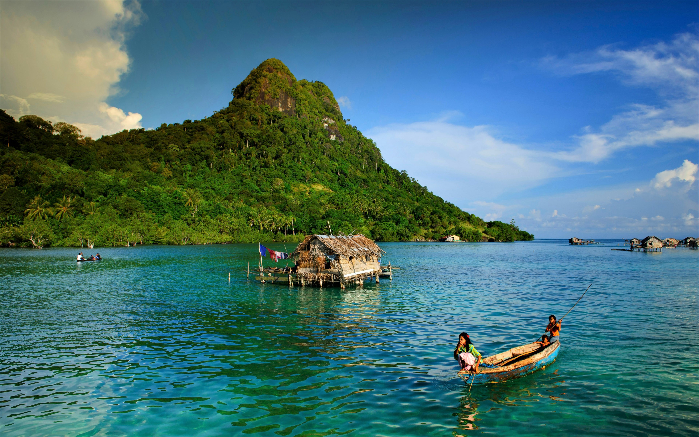

BLUE ECONOMY MODEL
FOR SMALL ISLAND DEVELOMENT
Prof. Ir. R. Sjarief Widjaja, Ph.D
Head of Research and Human resource Agency,
Ministry Of Marine Affairs and Fisheries
Research Centre Building, ITS
2 Sept 2019
Ministry Of Marine Affairs and Fisheries

Slide 2

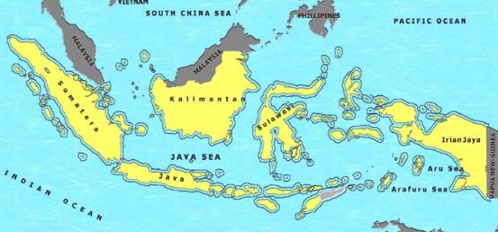
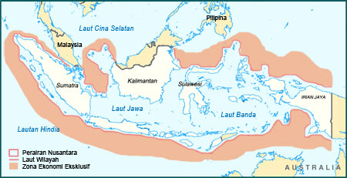
INDONESIA AN ARCHIPELAGIC STATE
Indonesia declared as an archipelagic state in 1957 / Djuanda Declaration (UNCLOS 1982), with regard to :
Right and obligation as a costal state with territory and inner seas
Right to exploit natural resources in Exclusive Economic Zone {EEZ) up to 200 miles
Before :
2.1 juta km²
After :
5.8 juta km²
Ministry Of Marine Affairs and Fisheries

Slide 3
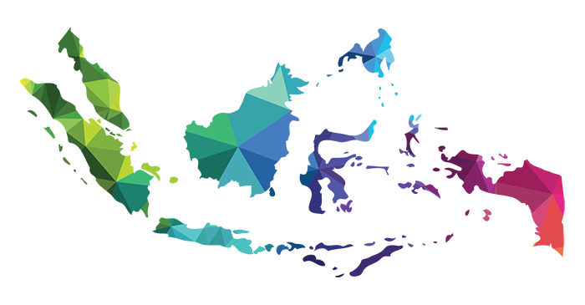
POTENSIAL OF INDONESIA AS A MARITIME COUNTRY
5,8 Million Km²
Or around 2/3 of the entire Indonesian
17.504
Island
MARINE
FISHERIES
STRATEGIC
AREA
DEFENSE
95,181 Km
Length of Beach
MARINE MEGA-BIODIVERSITY
3,1 Million Km²
Territorials Waters
8500
Fish Species
555
Seaweeds Species
950
Corals
2,7 Million Km²
Exclusive Economy Zone
* Based on Ministerial Decree KP No.47 / 2016, estimation of potential fish resources in WPP RI (MSY)
Ministry Of Marine Affairs and Fisheries

Slide 4
In the Rio+20 Conference in Brazil at the end of June 2012, the President of The Republic of Indonesia, not only invited the world to jointly implement a green economy in its national development, but also campaigned for a Blue Economy, where sea became an integral part of development goals sustainable development.
Geographically, Indonesia has a very strategic location, which is located between the Continent of Asia and Australia and the Indian Ocean and Pacific which make Indonesia as a trade route. The spirit of the rise of Indonesia as a maritime country emerged when it was declaration on December 13, 1957 and continued with the issuance of a Government Regulation in lieu of the Act which was later passed into UU No. 4 / PRP in 1960. The essence of the Djuanda Declaration of December 13, 1957 was the concept of an archipelagic state which was then stipulated as UU No. 4 about Indonesian waters.
The potential of marine resources, such as oil and gas, minerals and energy, sea transportation, maritime industries, fisheries and service industries such as tourism are very potential for national economic development
Ministry Of Marine Affairs and Fisheries

Slide 5
BLUE ECONOMY
AIM:
Increasing the efficiency of natural resources
Increasing added value and product diversification with the principle: natural resource efficiency without waste
Increasing community income
Employment expansion
APPROACH / STRATEGY:
Integrating production system across core business (main business)
Business connectivity (value chain and supply chain) and
Integrated infrastructure
LEADING COMMODITIES AND PRODUCTS:
Multiple commodities and products
New market development
SUSTAINABLE: Environmental insight
Ministry Of Marine Affairs and Fisheries

Slide 6
THE PRINCIPLE OF BLUE ECONOMY
MULTIPLE REVENUE
BUSINESS OPPORTUNITY:
  Saving Raw Materials and Energy
  Diversification of products / services
  High productivity
  Increased Value Added
  Quality Improvement
  Without Waste: Waste as a Derivative of Raw Material Product
  Natural Resource Efficiency and Costs, but in exchange Revenue Increases
ENHANCEMENT OF LABOR OPPORTUNITIES
INCREASING COMMUNITY INCOME
WON’T CAUSE ANY DAMAGE/CONTAMINATE THE ENVIRONMENT
EFFICIENT AND ENHANCING NATURE
Ministry Of Marine Affairs and Fisheries

Slide 7
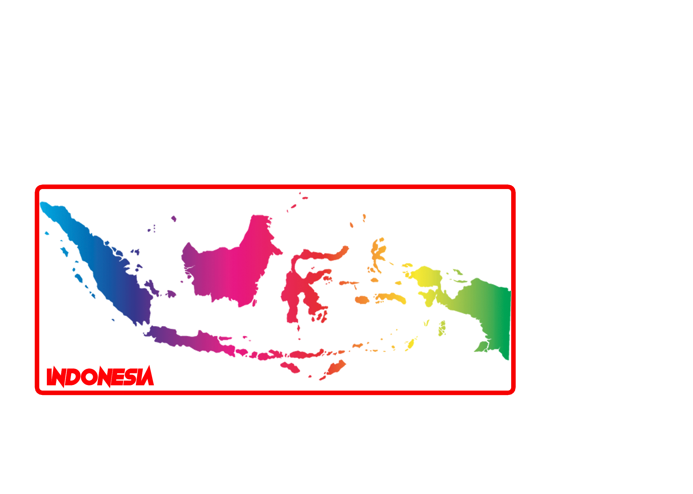
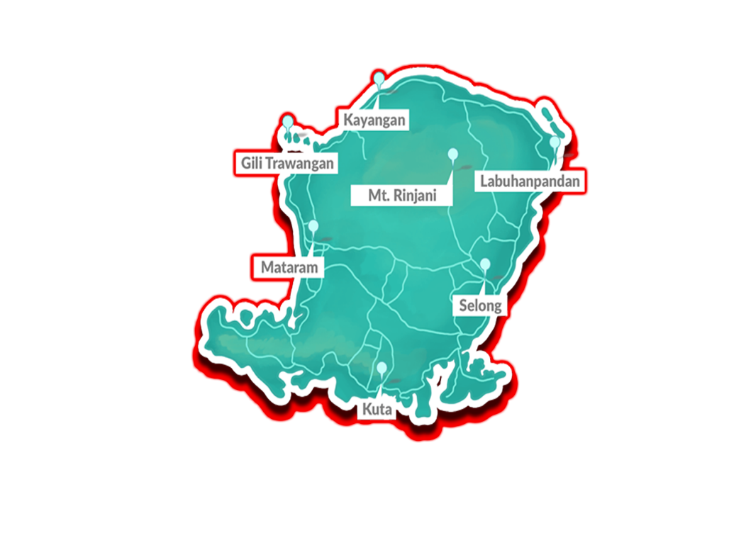
South East Lombok At Glance
CENTRAL LOMBOK
EAST LOMBOK
TOTAL
MARINE AREA
1,208.39 KM2
1,605.55 KM2
2,813.94 KM2
LAND AREA
417. 65 KM2
1,074.33 KM2
1,491.98 KM2
POPULATION
282,775 people
320,804 people
603,579 people
COASTLINE
99.69 KM
260.71 KM
360.40 KM
SMALL ISLAND
20 islands
35 islands
55 islands
Ministry Of Marine Affairs and Fisheries

Slide 8
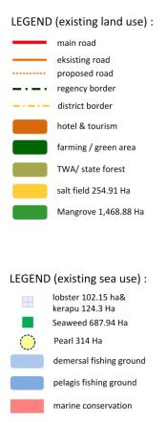

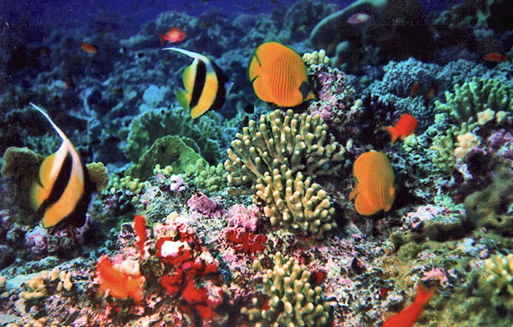
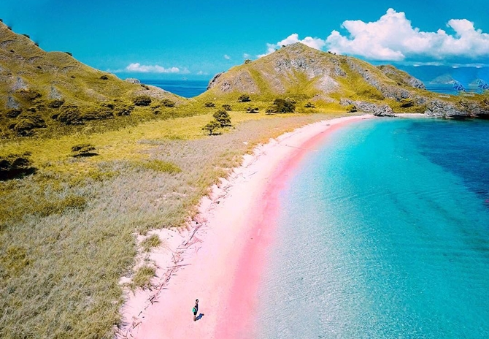

Geographical Map Of
Middle and South Lombok
Kuta Bay
Bumbang
Bay
Marine Concervation
Ministry Of Marine Affairs and Fisheries

Slide 9
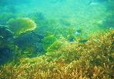
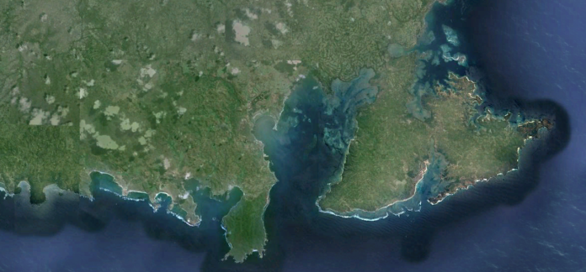
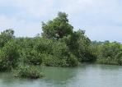
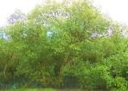



COASTAL ECOSYSTEM IN MIDDLE AND SOUTH LOMBOK
Mangrove forest (mangrove) : Jerowaru ( 1,425 Ha), Praya Timur and Pujut (43.87 Ha)
Coral reef : Jerowaru (565.4 Ha), Praya Timur and Pujut (600.12 Ha)
MSc COURSE IN FISHERIES BUSINESS – AUP FISHERIES POLYTECHNIC
Ministry Of Marine Affairs and Fisheries
Notes:
Luas wilayah
Darat :1.208, 39 Km
Laut :417 , 65 Km
Panjang Garis Pantai : 99, 69 Km
Kecamatan pesisir : 12 buah
Pulau2 kecil : 21 bh
East Lombok
Darat :1.605,55 km²
Laut : 1.074,33 km²
Panjang Garis Pantai : Km
Kecamatan pesisir : 20 buah
Pulau-pulau kecil:

Slide 10
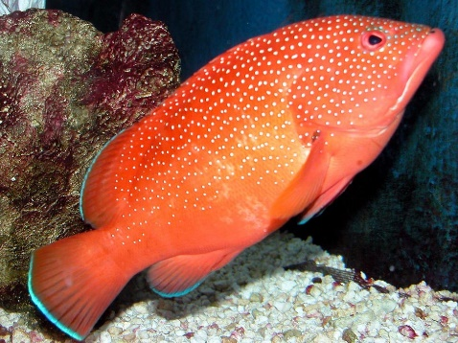
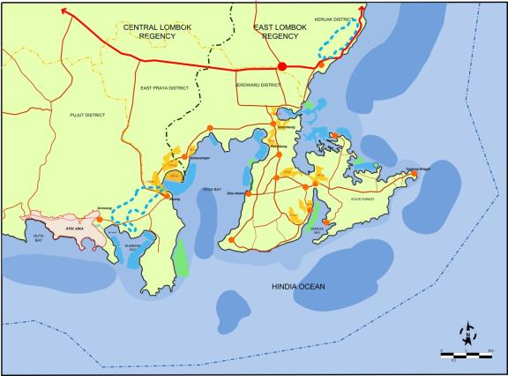
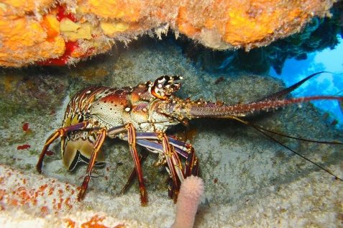
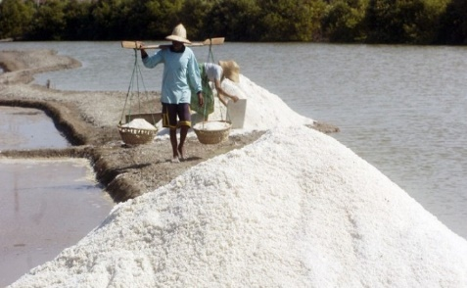
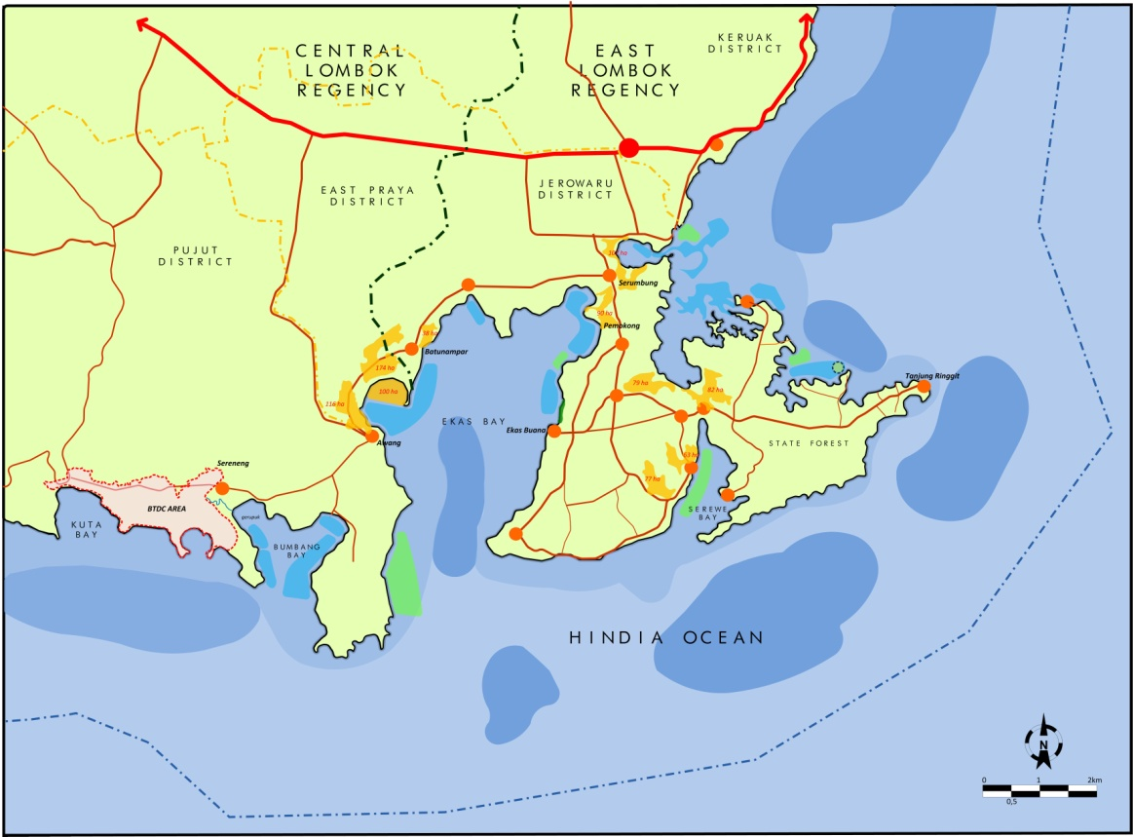
MARINE NATURAL RESOURCES IN LOMBOK
LOBSTER
Potential : 1,164.18Ha
Existing Area : 102.15 Ha
Production : 146 tons
(2012)
GROUPER
Potential : 1,709.4 Ha
Existing Area : 124.3 Ha
Production : 42.258 tonnes (2012)
PEARL
Potential : Jerowaru 786 Ha, East Praya : 5 Ha, Pujut 856.3 Ha
Existing Area : Jerowaru 314 Ha
Production : 0.20 tons
SEAWEED
Potential : 2,550 Ha
Existing Area : 687.94Ha
Production : 119,009ton
(2012)
SALT
Potential : 850 Ha
Existing Area : 254.91 Ha
Production : 10,870 ton
(2012)
Brackish Water Aquaculture (Shrimp, Milkfish)
MSc COURSE IN FISHERIES BUSINESS – AUP FISHERIES POLYTECHNIC
Ministry Of Marine Affairs and Fisheries
Notes:
Luas wilayah
Darat :1.208, 39 Km
Laut :417 , 65 Km
Panjang Garis Pantai : 99, 69 Km
Kecamatan pesisir : 12 buah
Pulau2 kecil : 21 bh
East Lombok
Darat :1.605,55 km²
Laut : 1.074,33 km²
Panjang Garis Pantai : Km
Kecamatan pesisir : 20 buah
Pulau-pulau kecil:

Slide 11
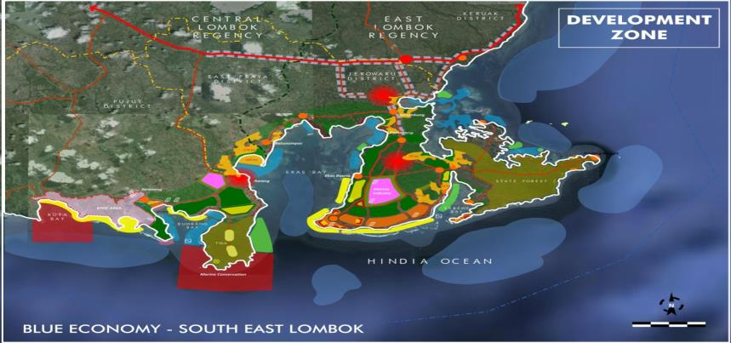


LOMBOK – REGIONAL DEVELOPMENT PLAN
A. ECO MARINE DEVELOPMENT CLUSTER BUMBANG :
Captured fishery, farming, water tourism, tourism accomodation, energy, marine culture, marine conservation, surveillance
B. ECO MARINE CLUSTER AWANG :
Marine industry, salt field, Livestock, culinary, marine culture, infrastructures, surveillance
C. ECO MARINE CLUSTER SRUMBUNG :
Salt field, captured fisheries, culinary, marine culture, survellance
D. ECO MARINE CLUSTER EKAS :
Marine industry, captured fishery, farming, livestock, water tourism, tourism accomodation, energy, research and development
E. ECO MARINE CLUSTER SEREWEH :
Captured fisheries, eco tourism, energy, marine culture, infratructures, sirveillance
C
B
E
A
D
MSc COURSE IN FISHERIES BUSINESS – AUP FISHERIES POLYTECHNIC
Ministry Of Marine Affairs and Fisheries
Notes:
Luas wilayah
Darat :1.208, 39 Km
Laut :417 , 65 Km
Panjang Garis Pantai : 99, 69 Km
Kecamatan pesisir : 12 buah
Pulau2 kecil : 21 bh
East Lombok
Darat :1.605,55 km²
Laut : 1.074,33 km²
Panjang Garis Pantai : Km
Kecamatan pesisir : 20 buah
Pulau-pulau kecil:

Slide 12
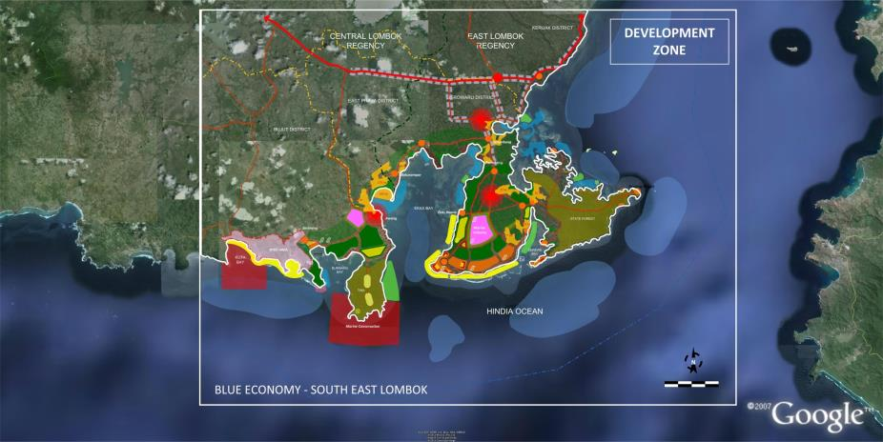
REGIONAL DEVELOPMENT PLAN FOR BLUE ECONOMY IN LOMBOK
01. Marine Industry
02. Salt Field
03. Captured Fishery
04. Farming
C
03
15
05. Lifestock
12
06. Eco-tourism
11
12
02
07. Water Tourism
02
12
06
08. Tourism Accom and festival
12
B
14
01
15
01
09. Energy and water
14
11
05
04
05
10
12
03
10. Research & Development
12
04
15
09
6
13
07
08
E
Bumbang
Bay
09
11. Culinary
09
06
12. Marine Culture
03
A
15
D
13. Marine Conservation
13
03
03
14. Infrastructure
15. Surveillance
MSc COURSE IN FISHERIES BUSINESS – AUP FISHERIES POLYTECHNIC
Ministry Of Marine Affairs and Fisheries
Notes:
Luas wilayah
Darat :1.208, 39 Km
Laut :417 , 65 Km
Panjang Garis Pantai : 99, 69 Km
Kecamatan pesisir : 12 buah
Pulau2 kecil : 21 bh
East Lombok
Darat :1.605,55 km²
Laut : 1.074,33 km²
Panjang Garis Pantai : Km
Kecamatan pesisir : 20 buah
Pulau-pulau kecil:

Slide 13
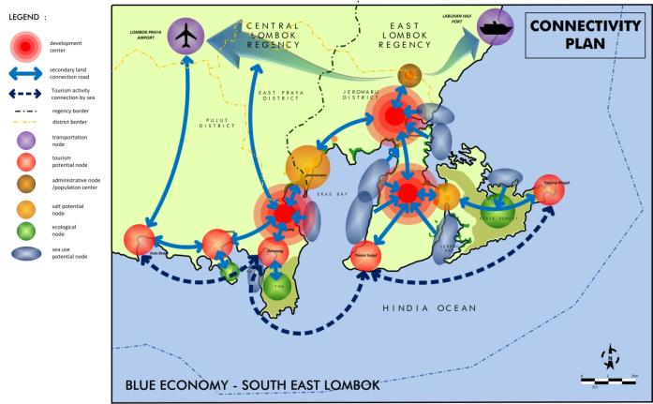
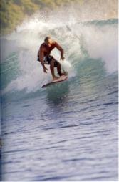
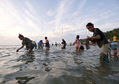
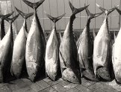
CONNECTIVITIES AMONG BLUE ECONOMIC ZONE
MSc COURSE IN FISHERIES BUSINESS – AUP FISHERIES POLYTECHNIC
Ministry Of Marine Affairs and Fisheries
Notes:
Luas wilayah
Darat :1.208, 39 Km
Laut :417 , 65 Km
Panjang Garis Pantai : 99, 69 Km
Kecamatan pesisir : 12 buah
Pulau2 kecil : 21 bh
East Lombok
Darat :1.605,55 km²
Laut : 1.074,33 km²
Panjang Garis Pantai : Km
Kecamatan pesisir : 20 buah
Pulau-pulau kecil:

Slide 14
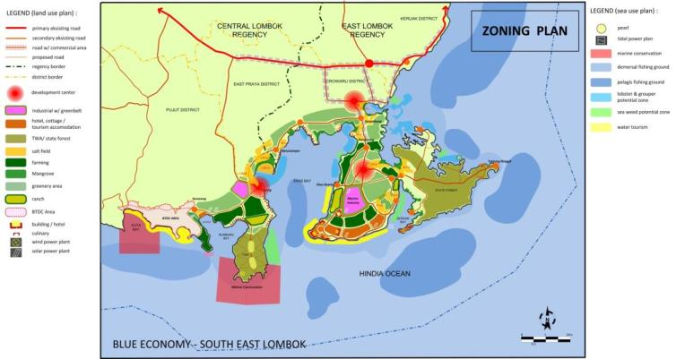
THE IMPLEMENTATION OF BLUE ECONOMY
IN LOMBOK - WEST NUSA TENGGARA PROVINCE - INDONESIA
ZONATION PLAN IN BLUE ECONOMY
Developing Integrated Economic Zones Based On The Principles Of Sustainability, Nature’s Efficiency, Zero Waste, And Social Inclusiveness
Kuta Bay
ANG
Y
Marine Concervation
MSc COURSE IN FISHERIES BUSINESS – AUP FISHERIES POLYTECHNIC
Ministry Of Marine Affairs and Fisheries
Notes:
Luas wilayah
Darat :1.208, 39 Km
Laut :417 , 65 Km
Panjang Garis Pantai : 99, 69 Km
Kecamatan pesisir : 12 buah
Pulau2 kecil : 21 bh
East Lombok
Darat :1.605,55 km²
Laut : 1.074,33 km²
Panjang Garis Pantai : Km
Kecamatan pesisir : 20 buah
Pulau-pulau kecil:

Slide 15
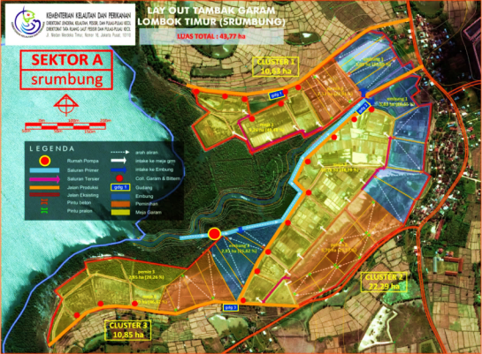
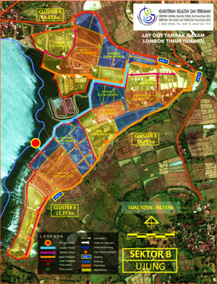
BLUE ECONOMY MODEL IN SALT PRODUCTION
MSc COURSE IN FISHERIES BUSINESS – AUP FISHERIES POLYTECHNIC
Ministry Of Marine Affairs and Fisheries
Notes:
Luas wilayah
Darat :1.208, 39 Km
Laut :417 , 65 Km
Panjang Garis Pantai : 99, 69 Km
Kecamatan pesisir : 12 buah
Pulau2 kecil : 21 bh
East Lombok
Darat :1.605,55 km²
Laut : 1.074,33 km²
Panjang Garis Pantai : Km
Kecamatan pesisir : 20 buah
Pulau-pulau kecil:

Slide 16
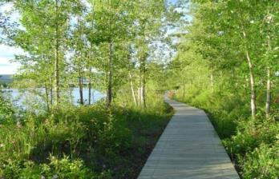
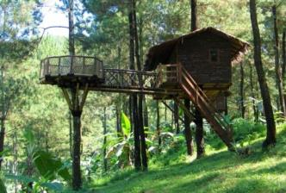
LOCATION FOR MARINE ECOTOURISM
The potential areas for eco-tourism include:
Tanjung Ringgit Preserve (Cagar Alam Tanjung Ringgit) - Lombok Timur
Gunung Tunak Nature Tourism Park (Taman Wisata Alam Gunung Tunak) – Lombok Tengah
Tanjung Ringgit Preserve
Gunung Tunak Nature Tourism Park
MSc COURSE IN FISHERIES BUSINESS – AUP FISHERIES POLYTECHNIC
Ministry Of Marine Affairs and Fisheries
Notes:
Luas wilayah
Darat :1.208, 39 Km
Laut :417 , 65 Km
Panjang Garis Pantai : 99, 69 Km
Kecamatan pesisir : 12 buah
Pulau2 kecil : 21 bh
East Lombok
Darat :1.605,55 km²
Laut : 1.074,33 km²
Panjang Garis Pantai : Km
Kecamatan pesisir : 20 buah
Pulau-pulau kecil:

Slide 17
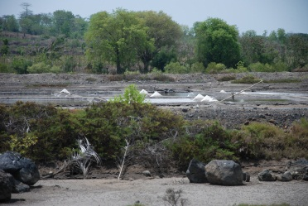
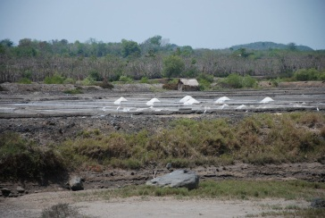
DEVELOMENT STAGES IN SALT PRODUCTION
PRECONDITION 1
PRECONDITION 2
PRECONDITION 3
WATER MANAGEMENT, SALT FIELD ARRAGEMENT, TUF & GEOMEMBRANE, SALT FARMER EMPOWERMENT
STANDARIZATION, PACKAGING, MARKETING STRATEGY
ROAD PROVISION, SALT WAREHOUSE, SALT PROCESSING MACHINE
GO
Ministry Of Marine Affairs and Fisheries

Slide 18
PRODUCT DEVELOMENT
Ministry Of Marine Affairs and Fisheries

Slide 19
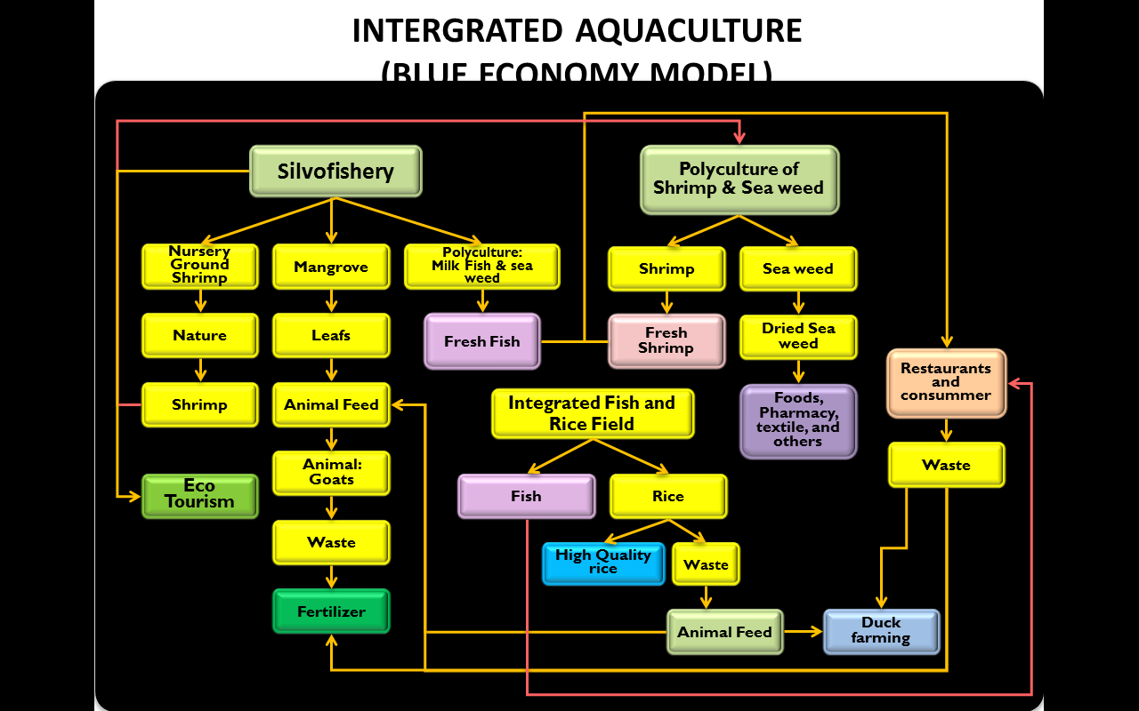
Ministry Of Marine Affairs and Fisheries

Slide 20
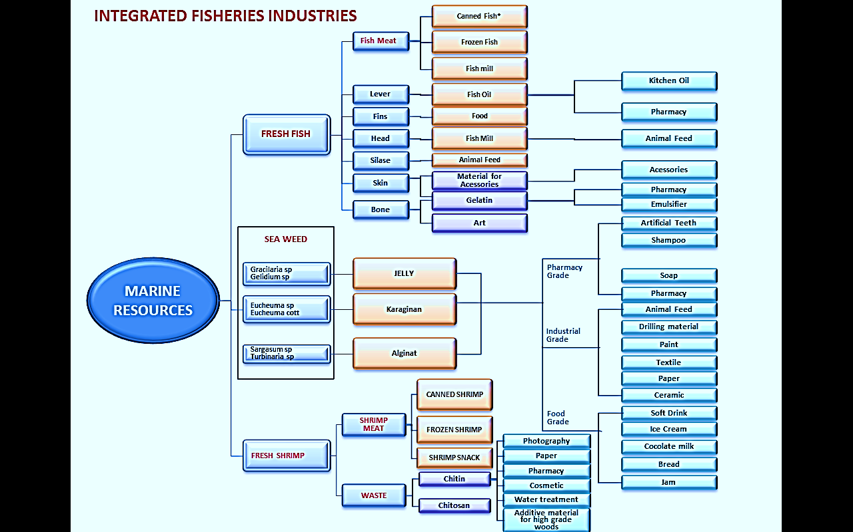
INTERGRATED AQUACULTURE ECONOMIC ACTIVITIES
Ministry Of Marine Affairs and Fisheries

Slide 21
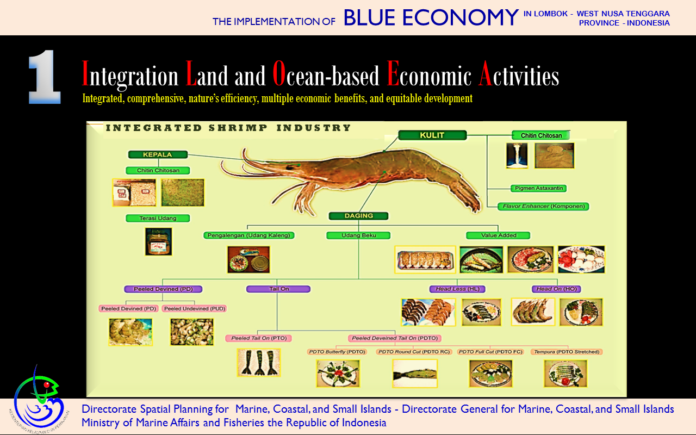
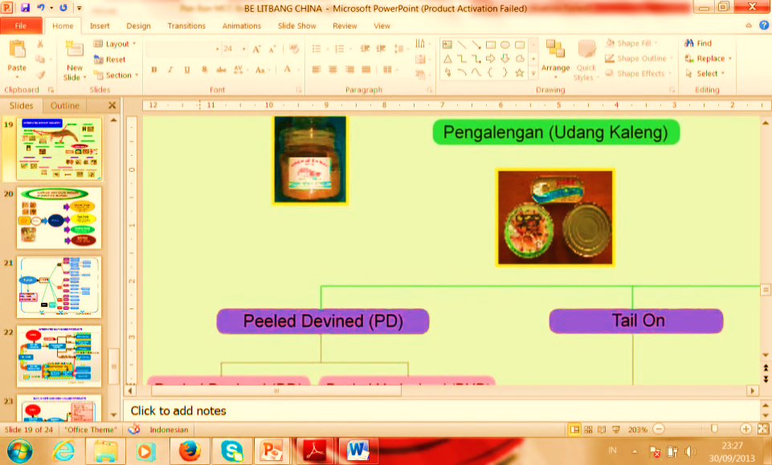
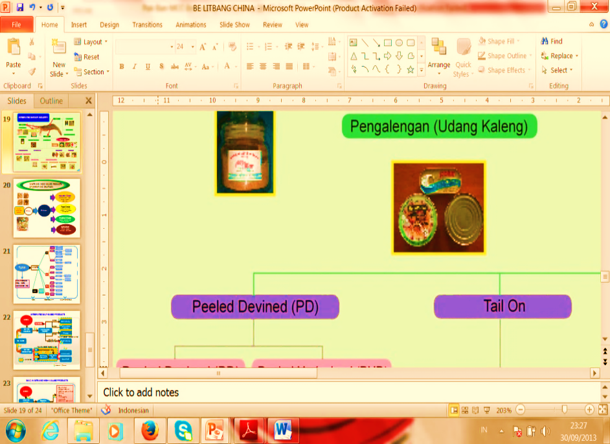
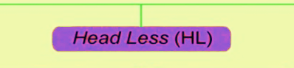
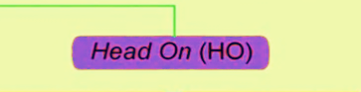
Ministry Of Marine Affairs and Fisheries

Slide 22
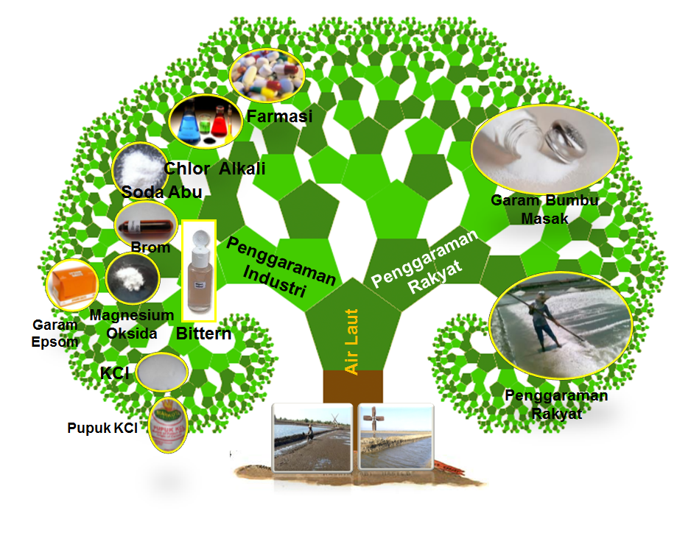
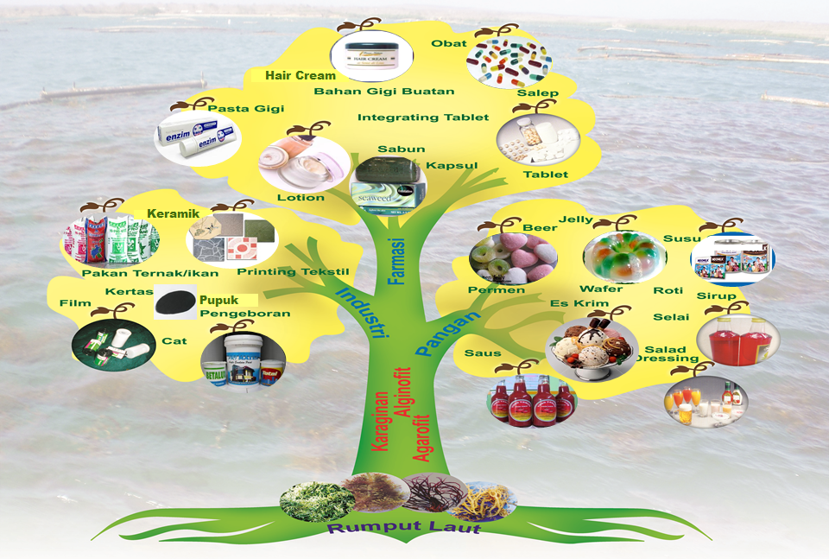
SALT DERIVATIVED PRODUCT
SEAWEED DERIVATIVED PRODUCT
SALT WATER
SEAWEED
Ministry Of Marine Affairs and Fisheries

Slide 23
THANKYOU
Ministry Of Marine Affairs and Fisheries

