Slide 1
PT. SURYA ENERGY SOLUTION
SEES Group Presentation, October 16, 2012
FOR INFORMATION PURPOSE ONLY
SEES Group

Slide 2
Line of Bussinness
Project Developer:
LED Ligthing
Rental Power
Electrical Related
Power Plant
Consulting
EPC
General Trading

Slide 3
PT SEES provides SOLUTIONS

Slide 4
THE PLATFORM

Slide 5
LED
PRODUCTION FACILITIES
Kajian Teknis
Oleh ITS
Kajian Komersial
Oleh SEES
Kajian Market
Oleh SEES
Raw Material
Manufacturing
Assembly Process
Critical Processes
Procurement
LED ASSEMBLY PARTNERS
SMKN 3 JOGJA
SMKN XXXX
Pesantren
SMKN XXXX

Slide 6
ACCOMPLISHMENTS

Slide 7
PT Jogja Pasthika Daya Signing MOU with SMKN3 Jogja

Slide 8
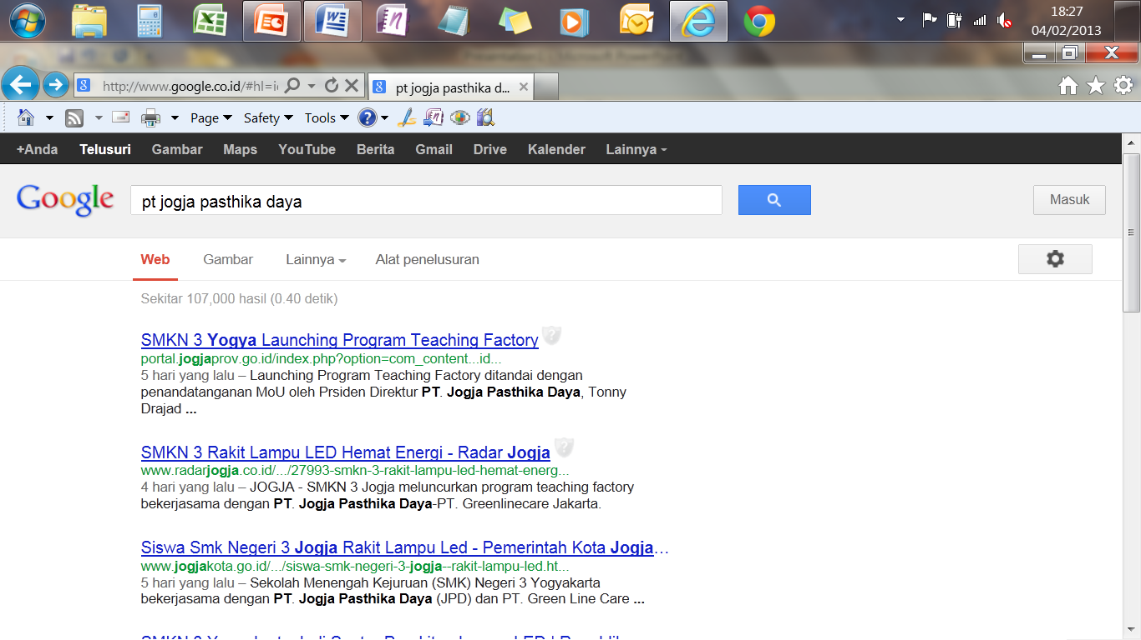
Google Search 1

Slide 9
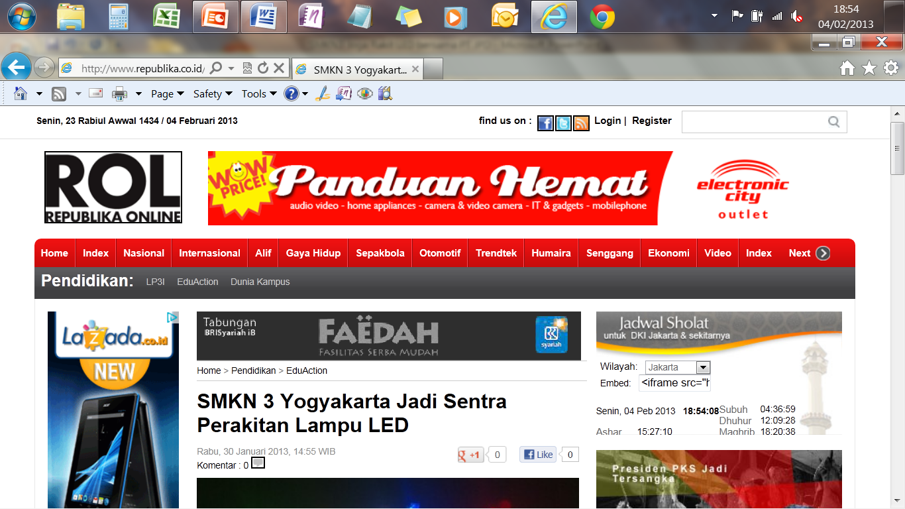
Republika on line 1

Slide 10
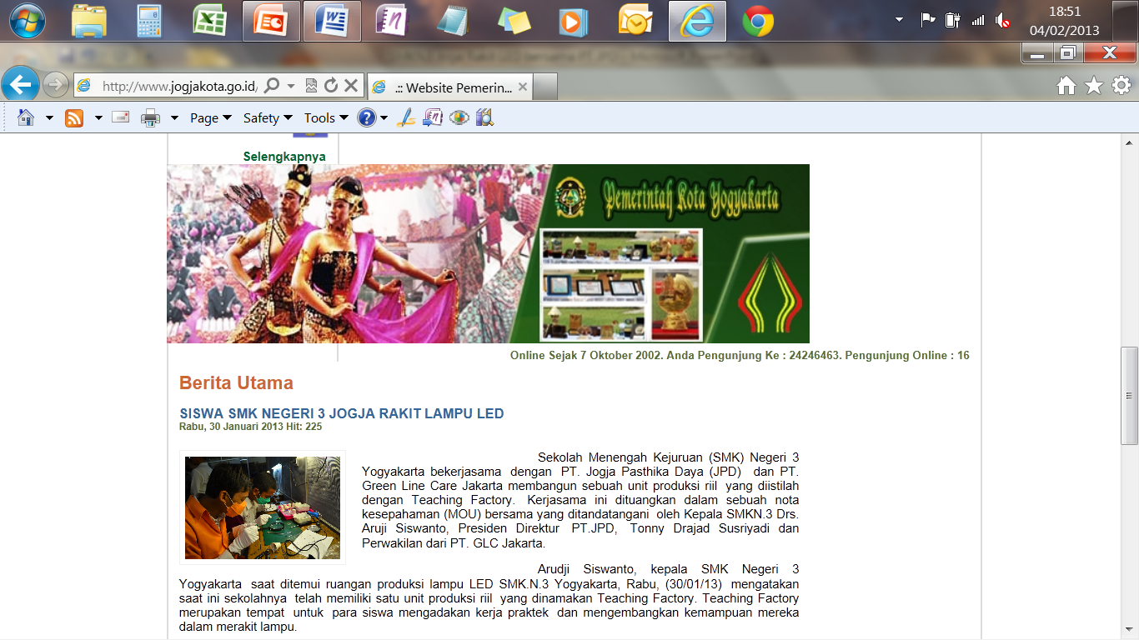

Slide 11
AGREEMENT WITH ITS

Slide 12
Foto LED Assembly di SMNK3 Jogja
Jan 31 2013

Slide 16
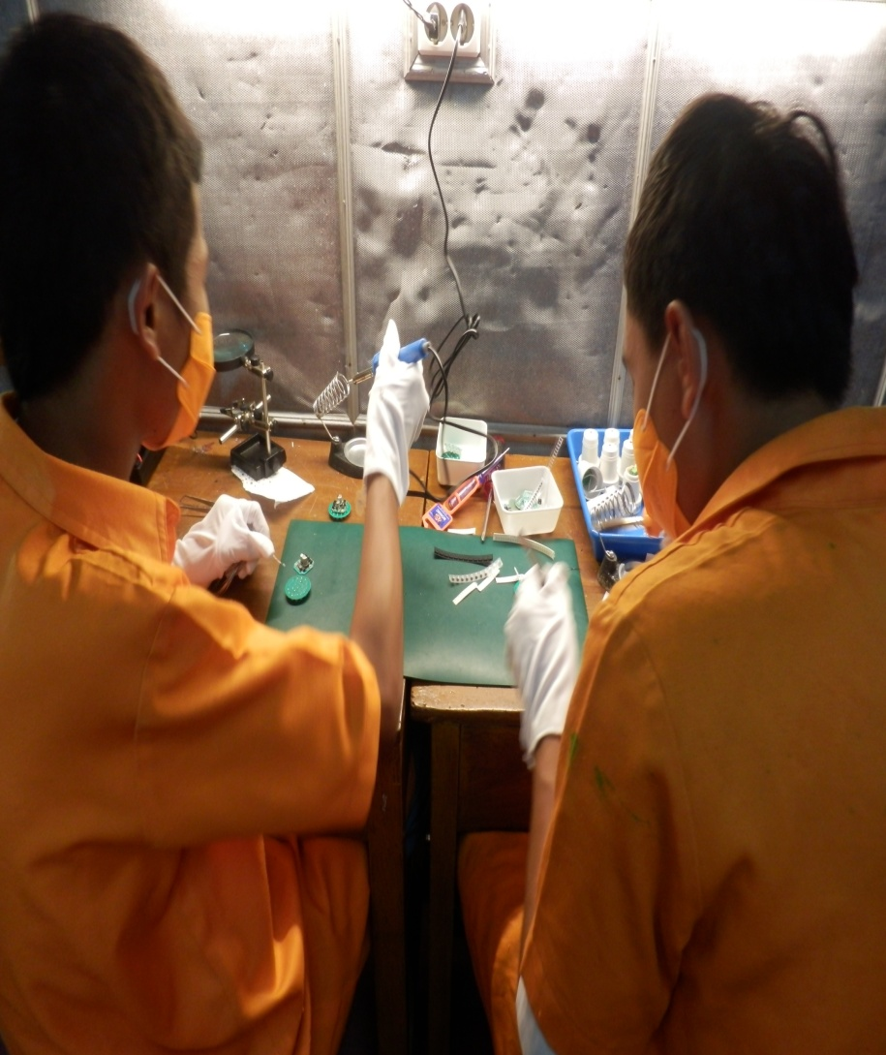

Slide 17
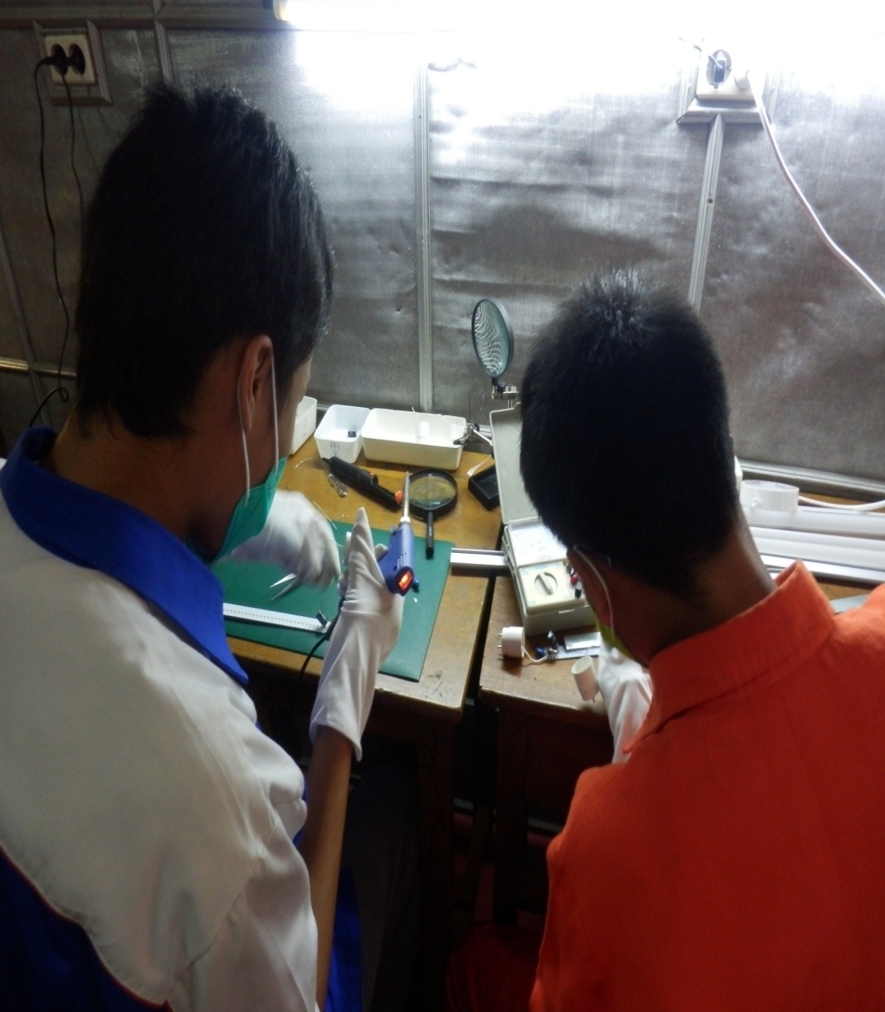

Slide 18
Foto2 sama Sultan Yogyakarta
April 2013

Slide 19
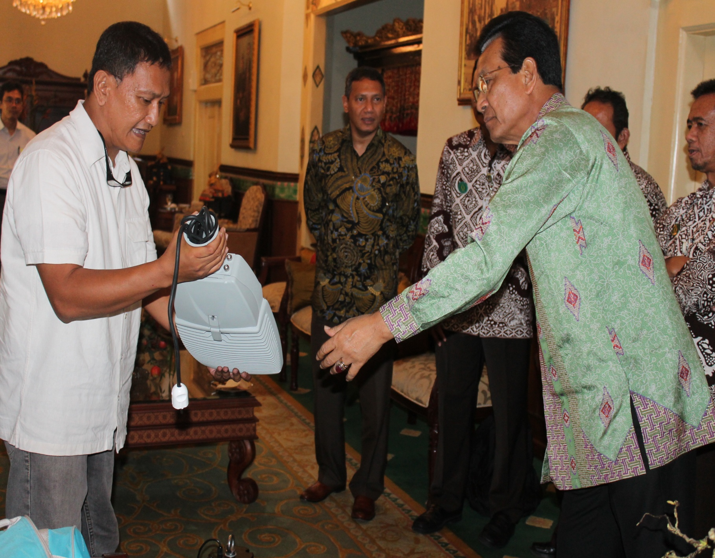

Slide 20
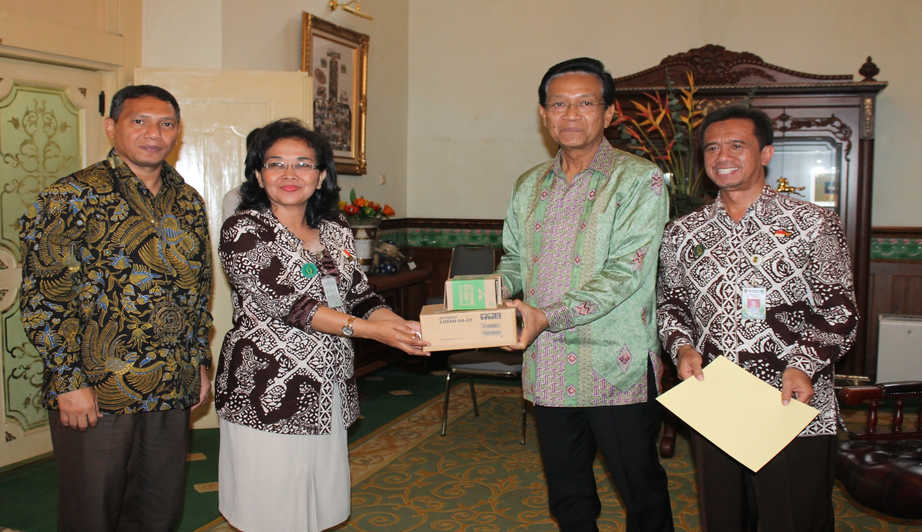

Slide 21
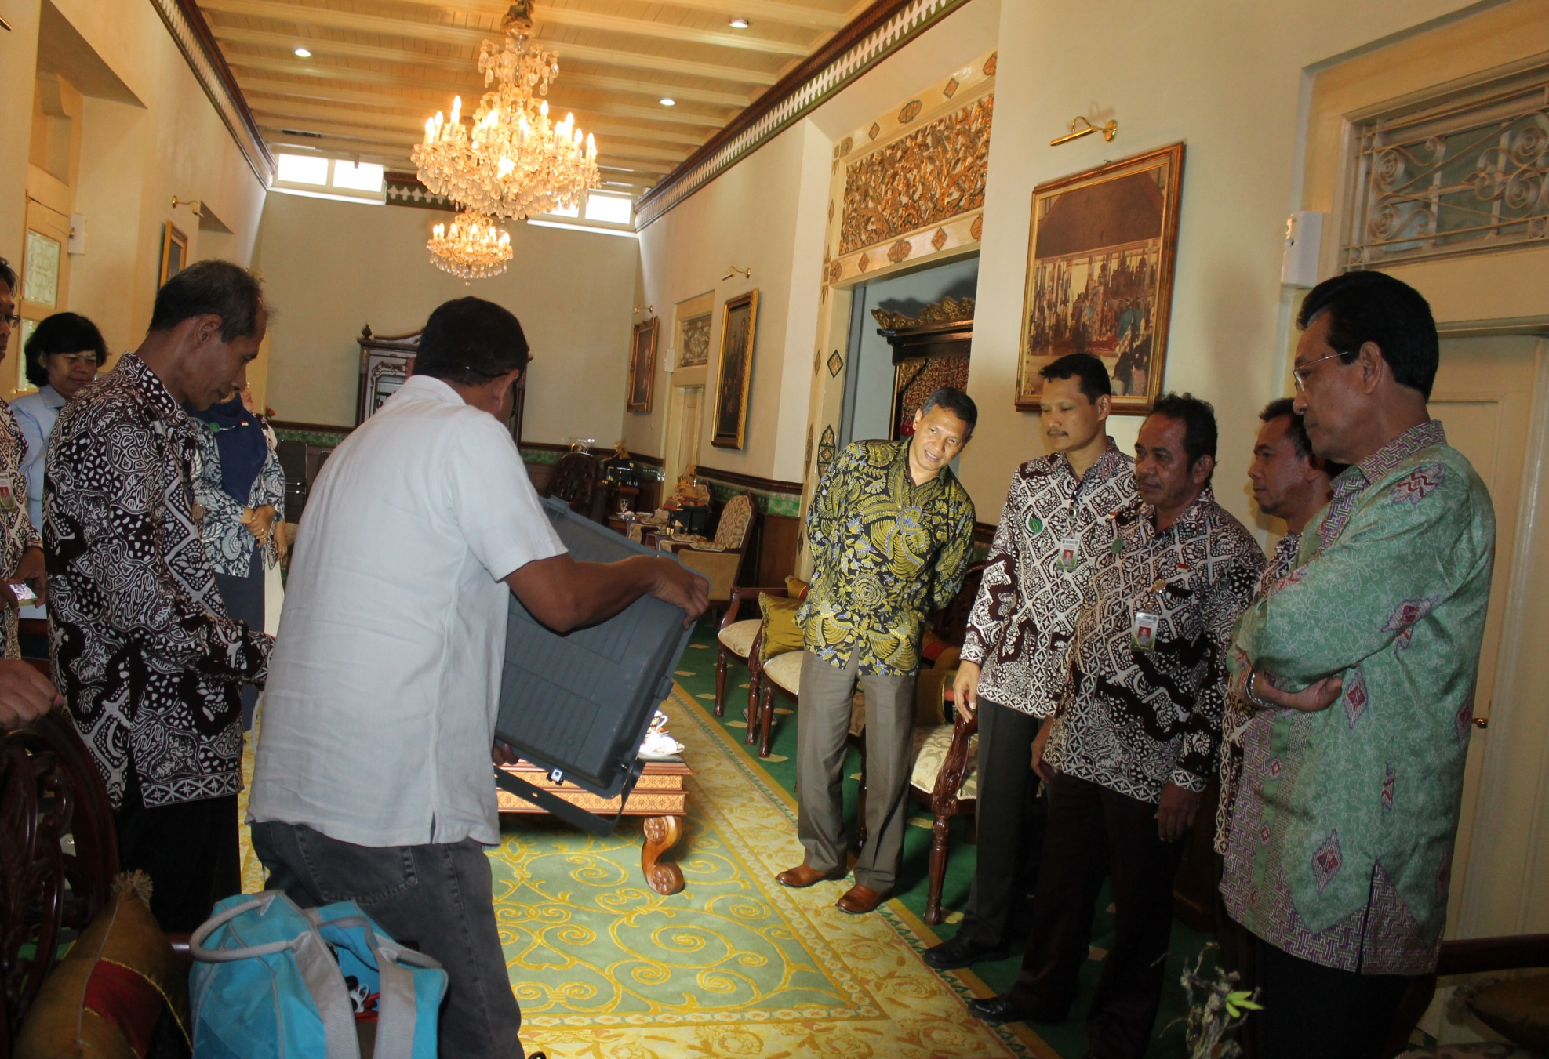

Slide 22
Foto sama ITS
Maret 2013

Slide 26
WE HAVE A STRONG PLATFORM TO GROW THE LED BUSINESS AND TRANSFER TECHNOLOGY TO INDONESIA

Slide 27
BACK UP SLIDES
Maret 2013

Slide 28
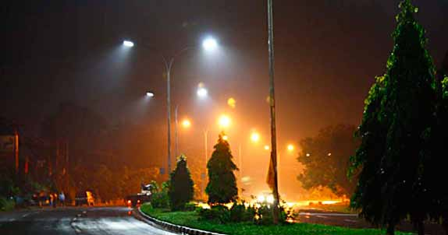
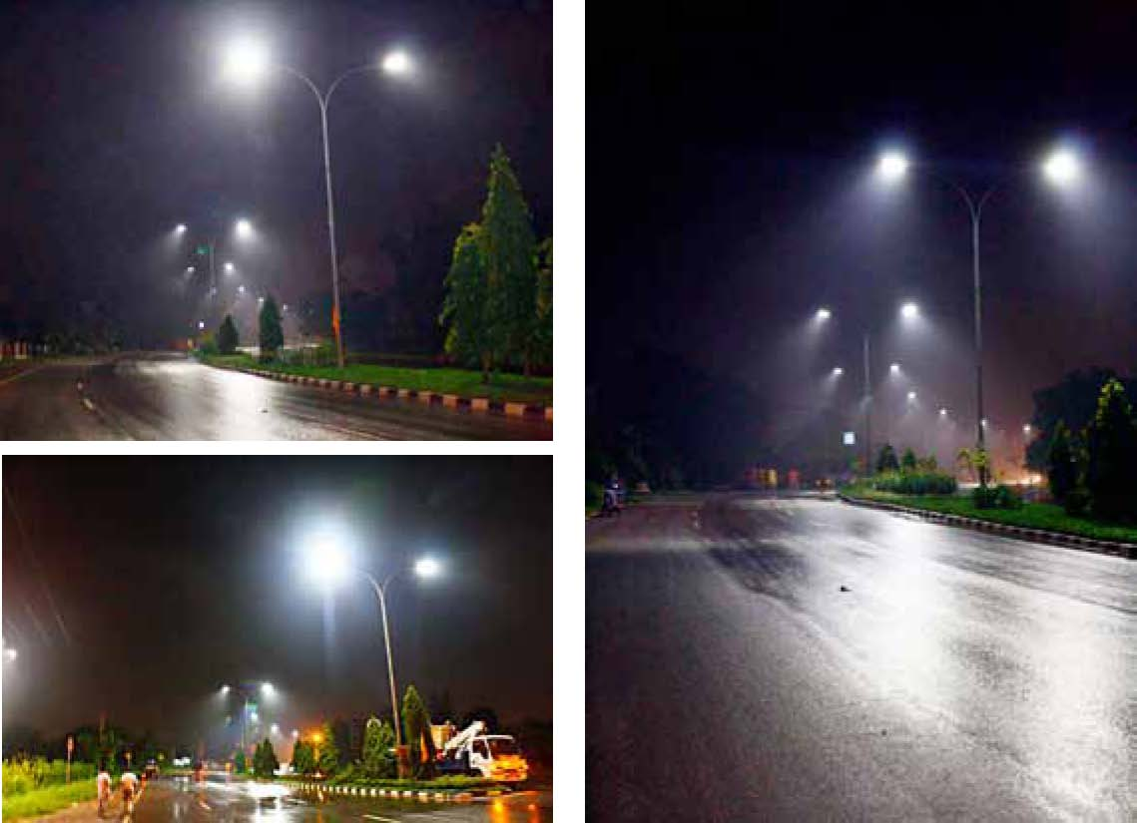
Pemasangan PJU di Palembang
PJU LED
Perbandingan PJU Lama dan PJU LED

Slide 29
PERUBAHAN TEKNOLOGI
API
LAMPU BOHLAM
LAMPU NEON
LAMPU LED
APAKAH KITA HANYA TERUS MENJADI PENONTON SAJA ?
LETS MAKE LED AND CREATE THE NEXT TECHNOLOGY.

